Slide 1
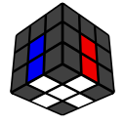
Solving the Cube – Pt. 1
Michael George
WCA ID: 2015GEOR02

Slide 2
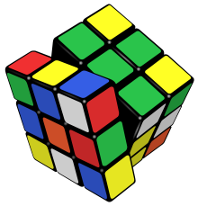
The World’s Most Famous Puzzle
Invented in 1974 by Ernő Rubik and originally called the “Magic Cube”
Debuted at the toy fairs in London, Paris, Nuremberg and New York in Jan + Feb 1980
350 million sold worldwide by January 2009
There are many permutations - 43,252,003,274,489,856,000 to be precise!

Slide 3

Goals
Simplicity
Solve the cube using short “intuitive” sequences of moves (AKA “triggers”)
Combine triggers to create simple “algorithms” which are easy to understand and remember
Promote a “beginner” method which can be upgraded to “intermediate” and “advanced” methods
Minimise the likelihood of messing up and having to redo earlier steps!
Tips
“Cross on bottom” gives the best visibility of unsolved pieces and helps with “look ahead”
“Finger tricks” is the term given to fast, ergonomic turns. They look cool and speed up your solves
Excessive “rotations” should be avoided because they waste time and affect spatial awareness
“Colour neutrality” helps to ensure a good start to your solves and is best learnt from the day one
SIMPLES!

Slide 4

Terminology
Core
The 6 “centre” pieces are attached to the core and their relative positions cannot change
Layers
The ”First 2 Layers” (F2L) is the name given to the bottom two layers
The “Last Layer” (LL) is the name given to the top layer
Pieces
“Cubies” – 6 “centres”, 8 “corners” and 12 “edges”
“Orientation” – e.g. “flipped” edges and “twisted” corners
“Permutation” – e.g. relative positions of the edges and corners
F2L???

Slide 5

Notation
Face Turns
Face turns use the letters R U F L D B but we won’t use D or B turns
The basic turns (e.g. R U F L) are 90º clockwise
Turns ending with an apostrophe (e.g. R’ U’ F’ L’) are 90º counter-clockwise, pronounced “R Prime”, etc.
Turns ending with a “2” (e.g. R2 U2 F2 L2) are 180º and can be finger-tricked with a ”double flick”
Cube Rotations
Cube rotations use the letters x y z but we won’t use x or z
y is a 90º clockwise rotation around the y-axis. It goes in the same direction as U
y’ is a 90º counter-clockwise rotation around the y-axis. It goes in the same direction as U’
Fancy Moves
Wide turns (r u f l d b) affect an inner + outer layer at the same time but won’t be used in this method
Slice turns (M E S) affect an inner layer or both outer layers but won’t be used in this method
U R U’ R’

Slide 6
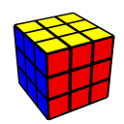
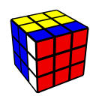
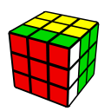
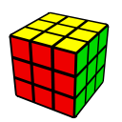
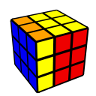
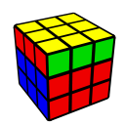
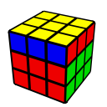
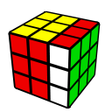
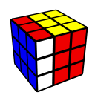
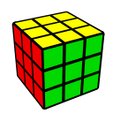
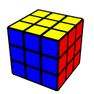
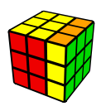
Basic Moves
Blue on Left
Red on Front
Green on Right
F
F’
L
U
U’
R
L’
y
y’
R’

Slide 7
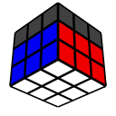
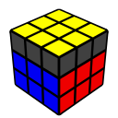
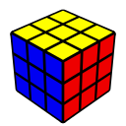
Method / Framework - CFOP
The Cross – 4 edges
First Two Layers (F2L)
Orientation of the Last Layer (OLL)
Permutation of the Last Layer (PLL)

Slide 8
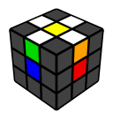
Step 1 – The “Cross”
The word “intuitive” is commonly used but it is a relative term and assumes some familiarity with the cube
Step 1.1
Get all 4 cross pieces into the U-Layer (AKA The “Daisy”) – intuitive
Step 1.2
Align one of the cross pieces with its respective centre
Solve the cross piece using R2 or L2 thus moving it from the U-layer to the D-layer
… repeat for the remaining 3 cross pieces
Once comfortable with this approach try to solve cross pieces directly to the D-Layer - slightly harder!

Slide 9

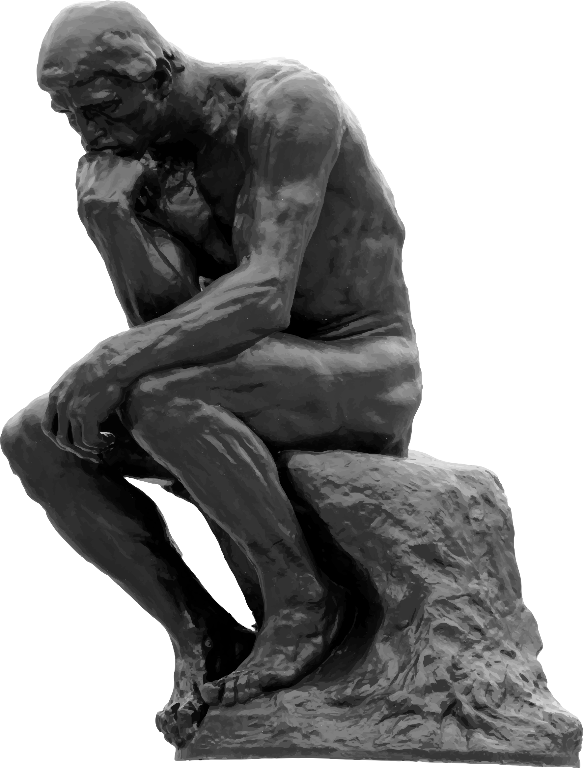
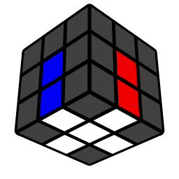
“Just Do It”

Slide 10

Homework

